Slide 1
traceroute Lab

Slide 2
Trace Route Lab
Materials needed
Computer system connected to internet
Software Tools used
traceroute command (Linux and Mac OS)
tracert command (Windows OS)
tracepath command (Chromebooks)

Slide 3
Objectives Covered
Security+ Objectives (SY0-501)
Objective 4.1 – Given a scenario, use the appropriate tool to assess organizational security
Network Reconnaissance and Discovery
tracert/traceroute

Slide 4
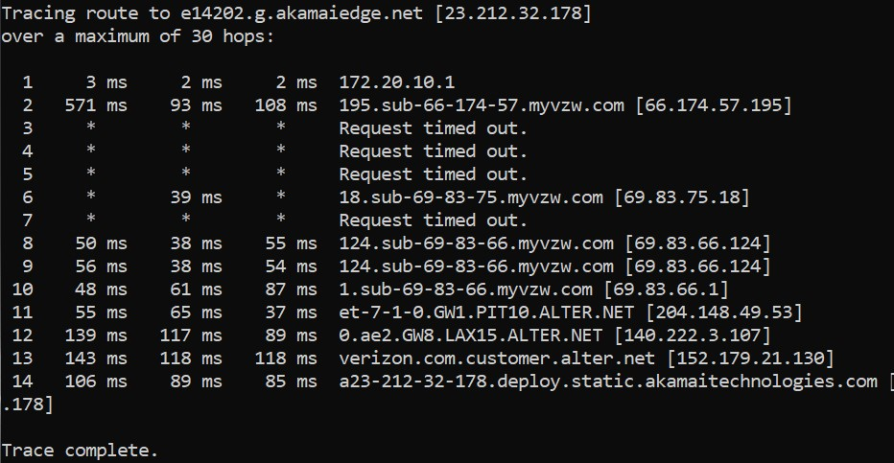
What is Trace Route?
The trace route command shows the path packets take across a network
Shows IP addresses of all the hops
Shows the time between the hops
Example of a trace route
Notes:
Bank: Chase
Username: jsmith17 Password: @pp13s33d

Slide 5
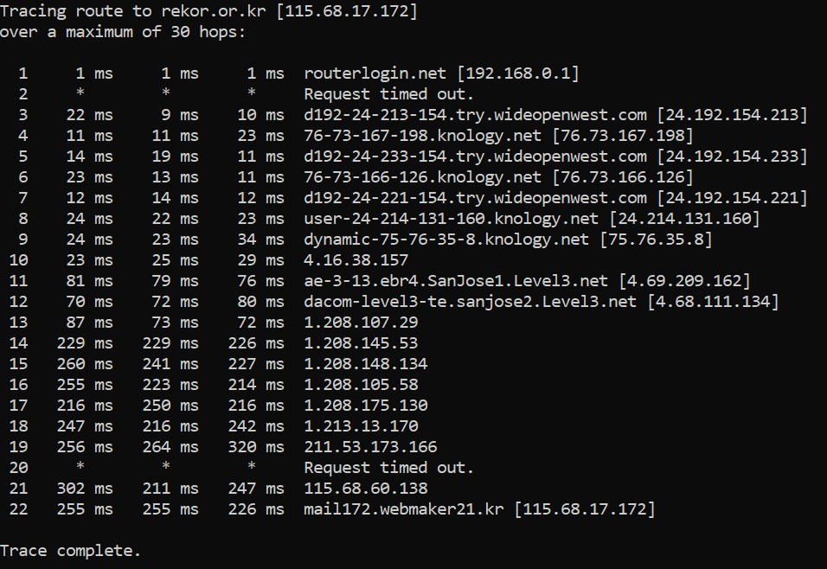
The Trace Route Lab
Open Terminal
Run a Trace Route
Analyze a Trace Route
Analyze a Secure Website
Your Turn

Slide 6
Open the Terminal
Once logged into the system*, open the Terminal
Open the Terminal in a Linux system
Can press CTRL+ALT+T in most Linux systems
Open the Command Prompt in a Windows system
Search for “cmd” to find the Command Prompt
Open Terminal in a Mac system
Search for “Terminal” using Spotlight
Open the Command Prompt on a Chromebook
CTRL+ALT+T should open the Command Prompt
*Please Note: This does not have to be done on a cyber range, this can be run on any operating system/computer

Slide 7
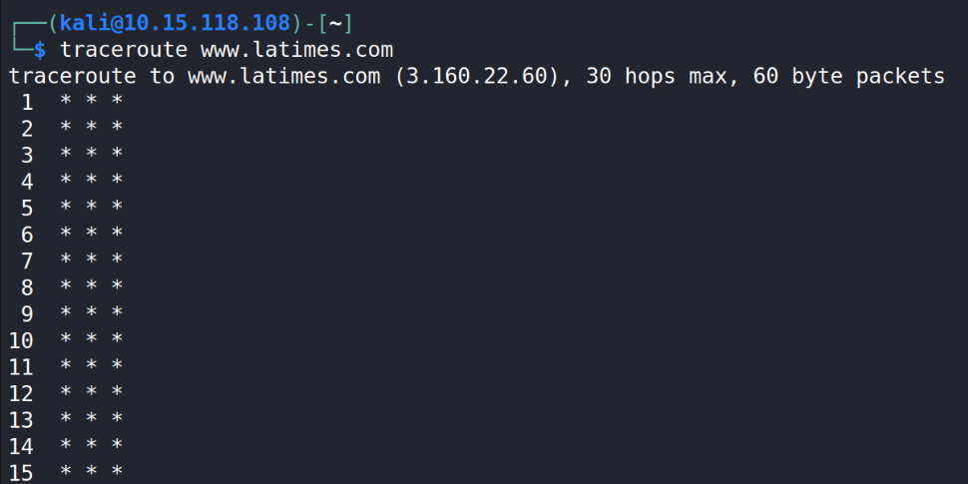
Note: May not work on some ranges
Some cyber ranges disable IMCP Traffic
Trace Route uses IMCP traffic to talk with the other hosts
Here is traceroute run on the US Cyber Range. Notice it does not show any data about the route. All ICMP packets are blocked.
Traceroute may need to be installed
Update the apt repository with sudo apt-get update
Then install with
sudo apt-get install traceroute
Please Note: This does not have to be done on a cyber range, this can be run on any operating system/computer

Slide 8
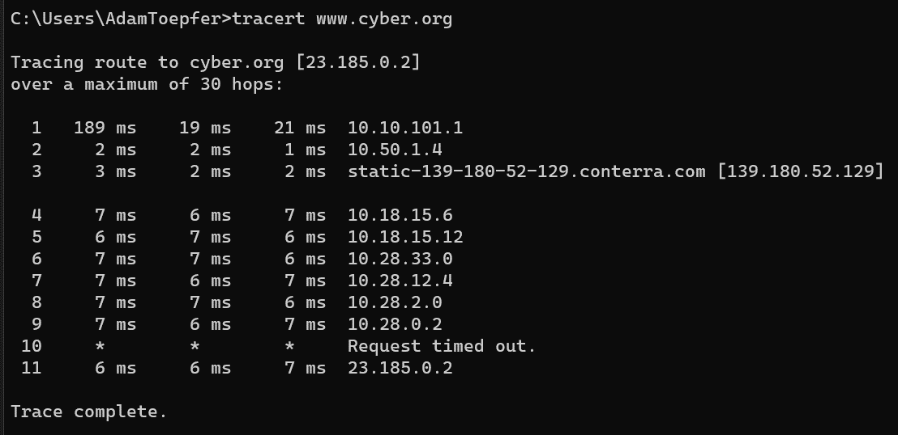
Run a Trace Route
Run a trace route to www.cyber.org
Windows Command:
tracert www.cyber.org
Linux/Mac Command:
traceroute www.cyber.org
Chromebook Command:
tracepath www.cyber.org
What data are you able to find? Notice anything cool/unique?
Notice that this trace route went through both North Carolina and Atlanta

Slide 9
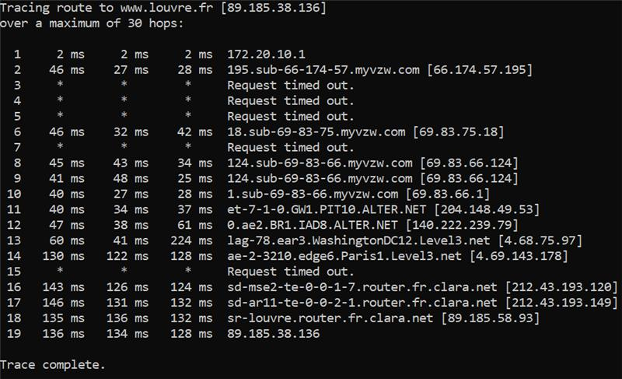
Analyze a Trace Route
Below is a trace route to www.louvre.fr (the Louvre’s website)
From Columbus, OH (Windows)
Can you identify the following route from the hostnames in the path?
Pittsburgh, PA
Dulles, VA
Washington D.C.
Paris, France
What does the “Request timed out” lines mean?

Slide 10
Analyze a Trace Route
Below is a trace route to www.louvre.fr (the Louvre’s website)
From Columbus, OH (Windows)
Pittsburgh, PA
Dulles, VA (IAD is the airport code for Dulles International Airport right outside Washington DC)
Washington, DC
Paris, France
France
A “request timed out” line means that the host refused to send back their details. How does this help secure this website?

Slide 11
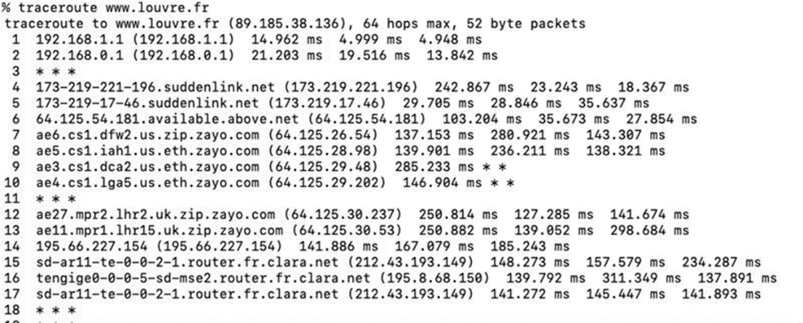
Analyze a Trace Route (Again)
Here is another traceroute to www.louvre.fr
From Bossier City, LA (Mac)
What route did this trace route take?
Can you find any cities in this path?
How did this trace route compare with the previous one?
Notice the time of the hops once it is overseas.

Slide 12
Analyze a Trace Route (Again)
Here is another traceroute to www.louvre.fr
Notice the time this hop takes
From Bossier City, LA (Mac)
Once overseas, notice it’s much longer
Can you follow this route?
Dallas, TX
Houston, TX
Washington D.C.
New York, NY
Great Britain (UK)
France

Slide 13
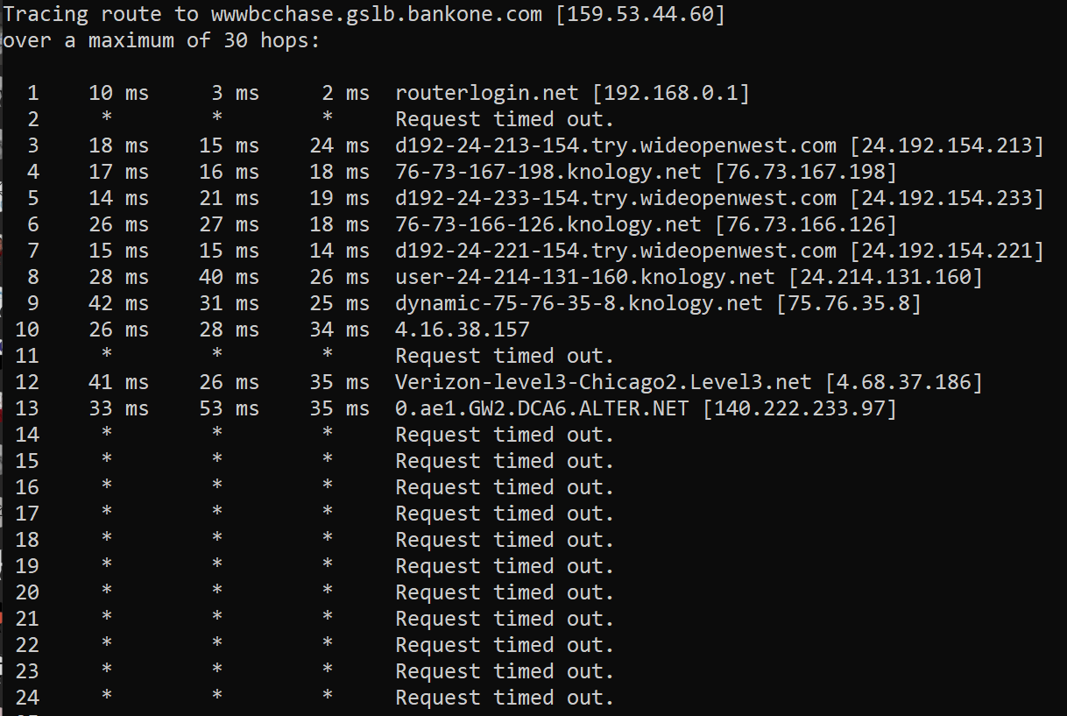
Analyzing a Secure Website
Let’s look at a traceroute to www.chase.com (Chase Bank)
Notice that Chase nodes do not respond back
Why would they do this?
Not sharing any data back

Slide 14
Your Turn
Run another traceroute to a different website
Examples:
bbc.co.uk
tpic.com.tr
dailymirror.lk
How many hops did it take?
What were you able to determine from this traceroute?
Any cool or interesting findings?

